Slide 1

Intelligent Robotics
ROS Project – Group 19
Agostini Francesco
Felline Andrea
Pietrobon Andrea
Accademic Year 23/24

Slide 2
Assignment 1

Slide 3
Assignment 1
1
2
3
Client-Server Communication
Actions and messages format
Movement
Detection
Server-Robot communication, move action management
Laser scan readings processing for cylinders detection

Slide 4
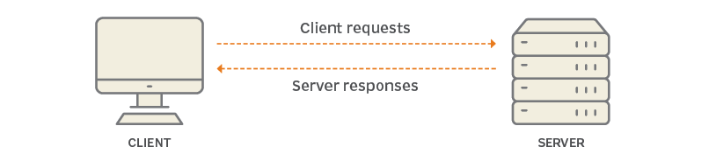
Client- Server Communication
Communication by using Messages and Action
Goal: a message with position and orientation
Feedback: a message with current position-orientation and a message with two lists of cylinders (currently in field of view and largest group ever seen)
Result: a message with the two lists content once the final position is reached
Notes:
Next: Andrea Pietrobon with Movement Management

Slide 5
Movement
The Tiago Server receive the goal message, take the coordinate and transform it in an object of type tf2::Quaternion.
Manage the movement of the robot by forwarding the goal to the navigation stack through the /move_base topic
During the movement the robot send back to the Tiago Server the information of the current position
During the movement of the robot is also scan the environment through the laser scan and return the relevant information through the /move_base/feedback topic
Number of cylinder that the robot is currently seen
Coordinates of the cylinder that appear on the robot’s radar
Max number of cylinders that the robot have seen

Slide 6
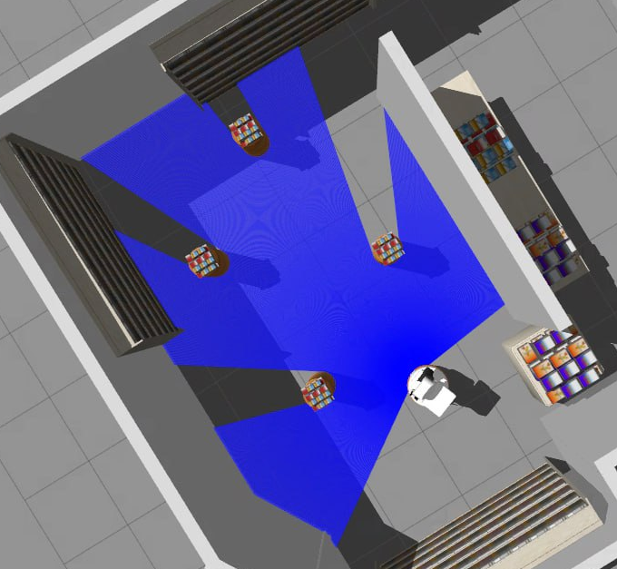
Detection
Detection based on laser scanner signal processing
Split laser scan result if distance point is over a defined threshold generating a sequence of profiles
Process each profile computing size and distance
Use size and shape criteria to filter only cylinder objects
Compute absolute position of the cylinder estimating center and size
For the detection we reused the Polar/Cartesian point system used in Ex4, good for code reuse but completely useless for 2nd Assignment.

Slide 7
Assignment 2

Slide 8
Assignment 2
1
2
3
Node A: Main
Takes user input and uses other nodes and functions to achieve the goal
Node B: manipulation
Node C: Detection
Manages movements of head, torso and arm
Detects obstacles, objects and tables

Slide 9
Node A: main idea
Contains the main function that uses all the others servers, classes and functionalities
The Human node sends the order of the objects that has to be picked up and placed
Then the node A executes a series of actions (i.e. moving to waypoints, detecting objects, pick and place them with the arm, …) to achieve the goal
Node B
Human node
Node A
Robot
Node C
Notes:
High level, receives the order and executes semi-fixed series of actions for each obj to pick it up and place on the right cylinder

Slide 10
Node A: details
For each object:
Go to the corresponding pose, eventually passing through additional waypoints to avoid collisions
Lift the torso and scan the table to get the poses of objects and obstacles
Reset the head position, pick the object and lower the torso
Move through waypoint(s) to go in front of cylinders
Detect cylinders colour and choose the right one (if the extra flag is active) or choose it automatically with constant positions (if the extra flag isn’t active)
Go in front of the cylinder, lift the torso, place the object and lower the torso
Go to waypoint 5 (a default waypoint near the table)
Repeat
Notes:
Node B: robot movement, Node C: detection next: Andrea Pietrobon with node B

Slide 11
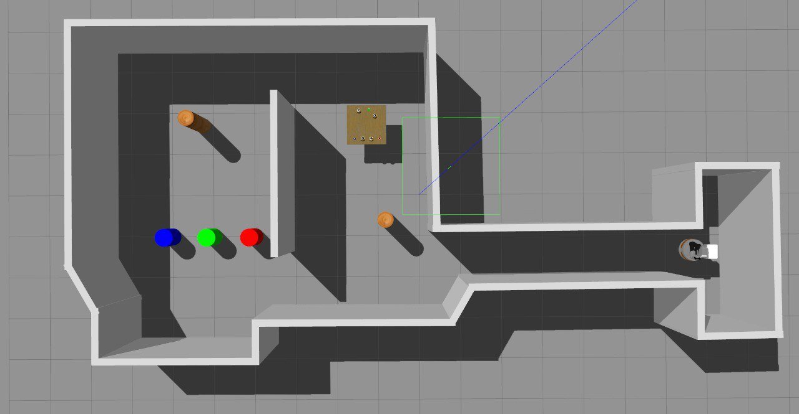
Node A: details
For each object:
Go to the corresponding pose, eventually passing through additional waypoints to avoid collisions
Lift the torso and scan the table to get the poses of objects and obstacles
Reset the head position, pick the object and lower the torso
Move through waypoint(s) to go in front of cylinders
Detect cylinders colour and choose the right one (if the extra flag is active) or choose it automatically with constant positions (if the extra flag isn’t active)
Go in front of the cylinder, lift the torso, place the object and lower the torso
Go to waypoint 5 (a default waypoint near the table)
Repeat
5
Notes:
Node B: robot movement, Node C: detection next: Andrea Pietrobon with node B

Slide 12
Package of Node B
1
2
3
Head Movement
Torso Lifter
Pick Place

Slide 13
Head Movement
It control the movement of the robot head. Initialize two clients to communicate with the robot's head controllers: one for moving the head according to a trajectory and the other for pointing it to a specific point in space.
The headMovementCallback function handles head movement requests from external clients. Depending on the mode specified in the request, the code performs different actions:
Mode 3: the code calls the pointHead function to point the head to the point specified by the pixels.
Mode 0, 1 or 2: the code sets the desired position of the head based on the given parameters and sends a motion target to the head motion control client.

Slide 14
Torso Lifter
The function takes 2 reference arguments:
For the service request
For the service response
The initial state of the motion group is set to its current state and the scaling factor of the maximum speed of the motion group is set to the value 1.0. At this point it generates a movement plan for lifting the torso.
If the movement plan is successfully generated, the robot executes the torso movement, returning the success value, which indicates whether the torso lifting was performed successfully.

Slide 15
Pick Place
The Pick and Place procedure pipeline is divided in different steps as following:
Define a collision object for every object detected on the table
Move the arm in a default pose
Move the arm to the position needed to pick up the object
Attach an object from the robot hand and Pick up it
Move the arm in a default pose
Move the arm to the position needed to pose the object

Slide 16
Package of Node C
1
2
3
Obstacle Extractor
Pose Table Detector, Poses Detection & Pose Transformer
Table Objects Detection

Slide 17
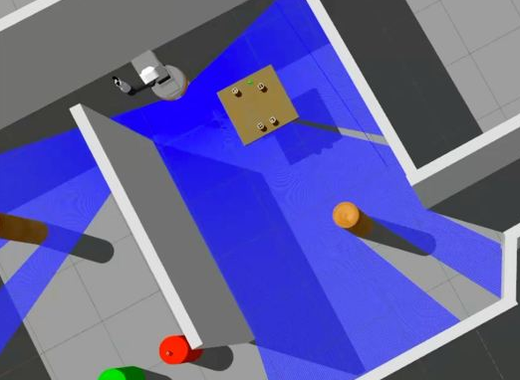
Obstacle Extractor
Understands where are the obstacles in the environment.
The process detect and process groups of points, forming segments, and eventually circles, with options to merge by using Split And Merge algorithm and filter them based on specified criteria.
These operations are the same as the one used for the first assignment.

Slide 18
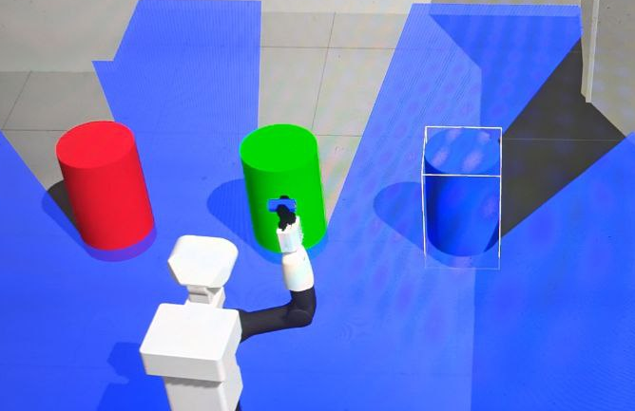
Pose Table Detector, Poses Detection & Pose Transformer
Pose Table Detector Captures the environment and by performing thresholds and point extraction operations, determines the mode based on the specified colour. Then it sorts the circles received in the request based on their x-coordinates and returns it based on the calculated mode.
Poses Detection Establishes a ROS service server for transforming poses between
specified frames. Captures AprilTag detections, send it to Poses
transformer and publishes the results on a specified topic.
Poses Transformer Upon receiving a transformation request, uses the TF2 library to look up the transformation and applies it to the provided pose.

Slide 19
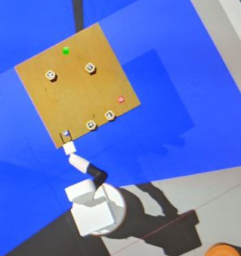
Table Object Detection
It provides methods for detecting and handling objects on the table and detects the table itself.
The constructor initializes an action server
Various methods are implemented for:
Moving the robot’s head
Capturing images
Interacting with detected objects
Start Detection orchestrates the entire detection process,
including pointing to the table, coloured objects, and
other obstacles.

Slide 20
It’s complete but…
VLAB Error
Often connection rejected, big waste of time
Pick and Place routines
Sometimes touches other obstables
Navigation Plan
Collision with table, required additional navigation step to avoid getting stuck

Slide 21
Thank you for the attention!

